Slide 1
Prolog
1972
A logic-based programming language associated with symbolic artificial intelligence.
CMPT 383
Summer 2022
SFU Surrey

Slide 2
What was going on in 1972?

Slide 3
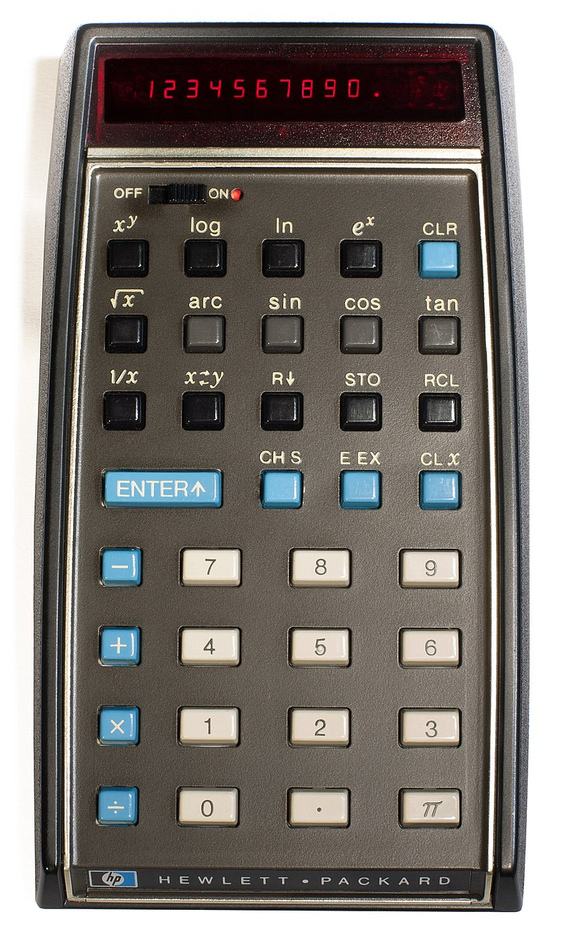
1972: First Appearances
HP-35 Pocket Scientific Calculator How much would you pay for it?
$395 in 1972
$2559 in 2021

Slide 4

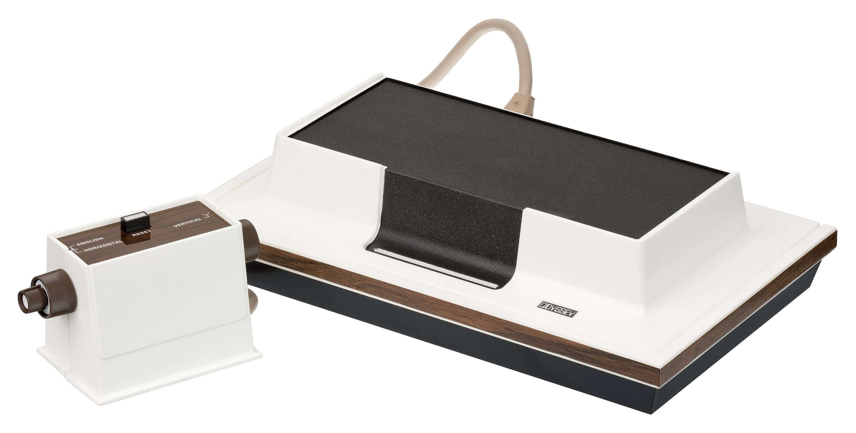
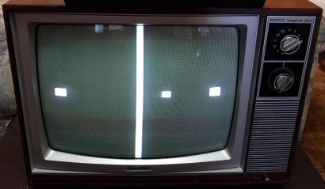
1972: First Appearances
Magnavox Odyssey First Home Video Game System
How much would you pay for it?
$99.95 in 1972
Table Tennis
$647 in 2021

Slide 5


1972: First Appearances
Nolan Bushnell

Slide 6
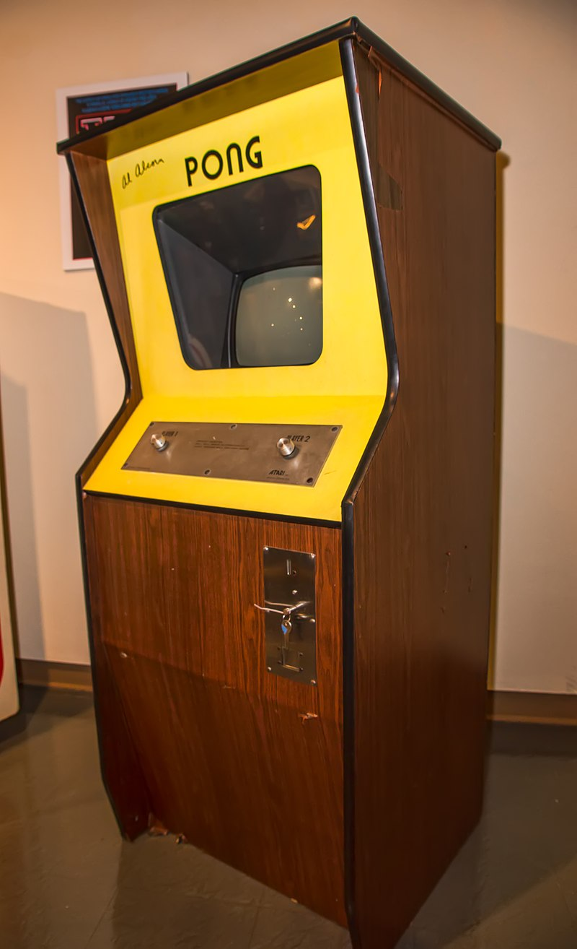
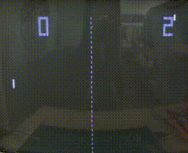
1972: First Appearances
Pong Atari’s 1st commercially successfully video game

Slide 7
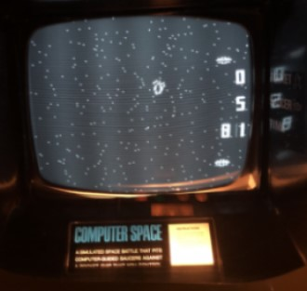
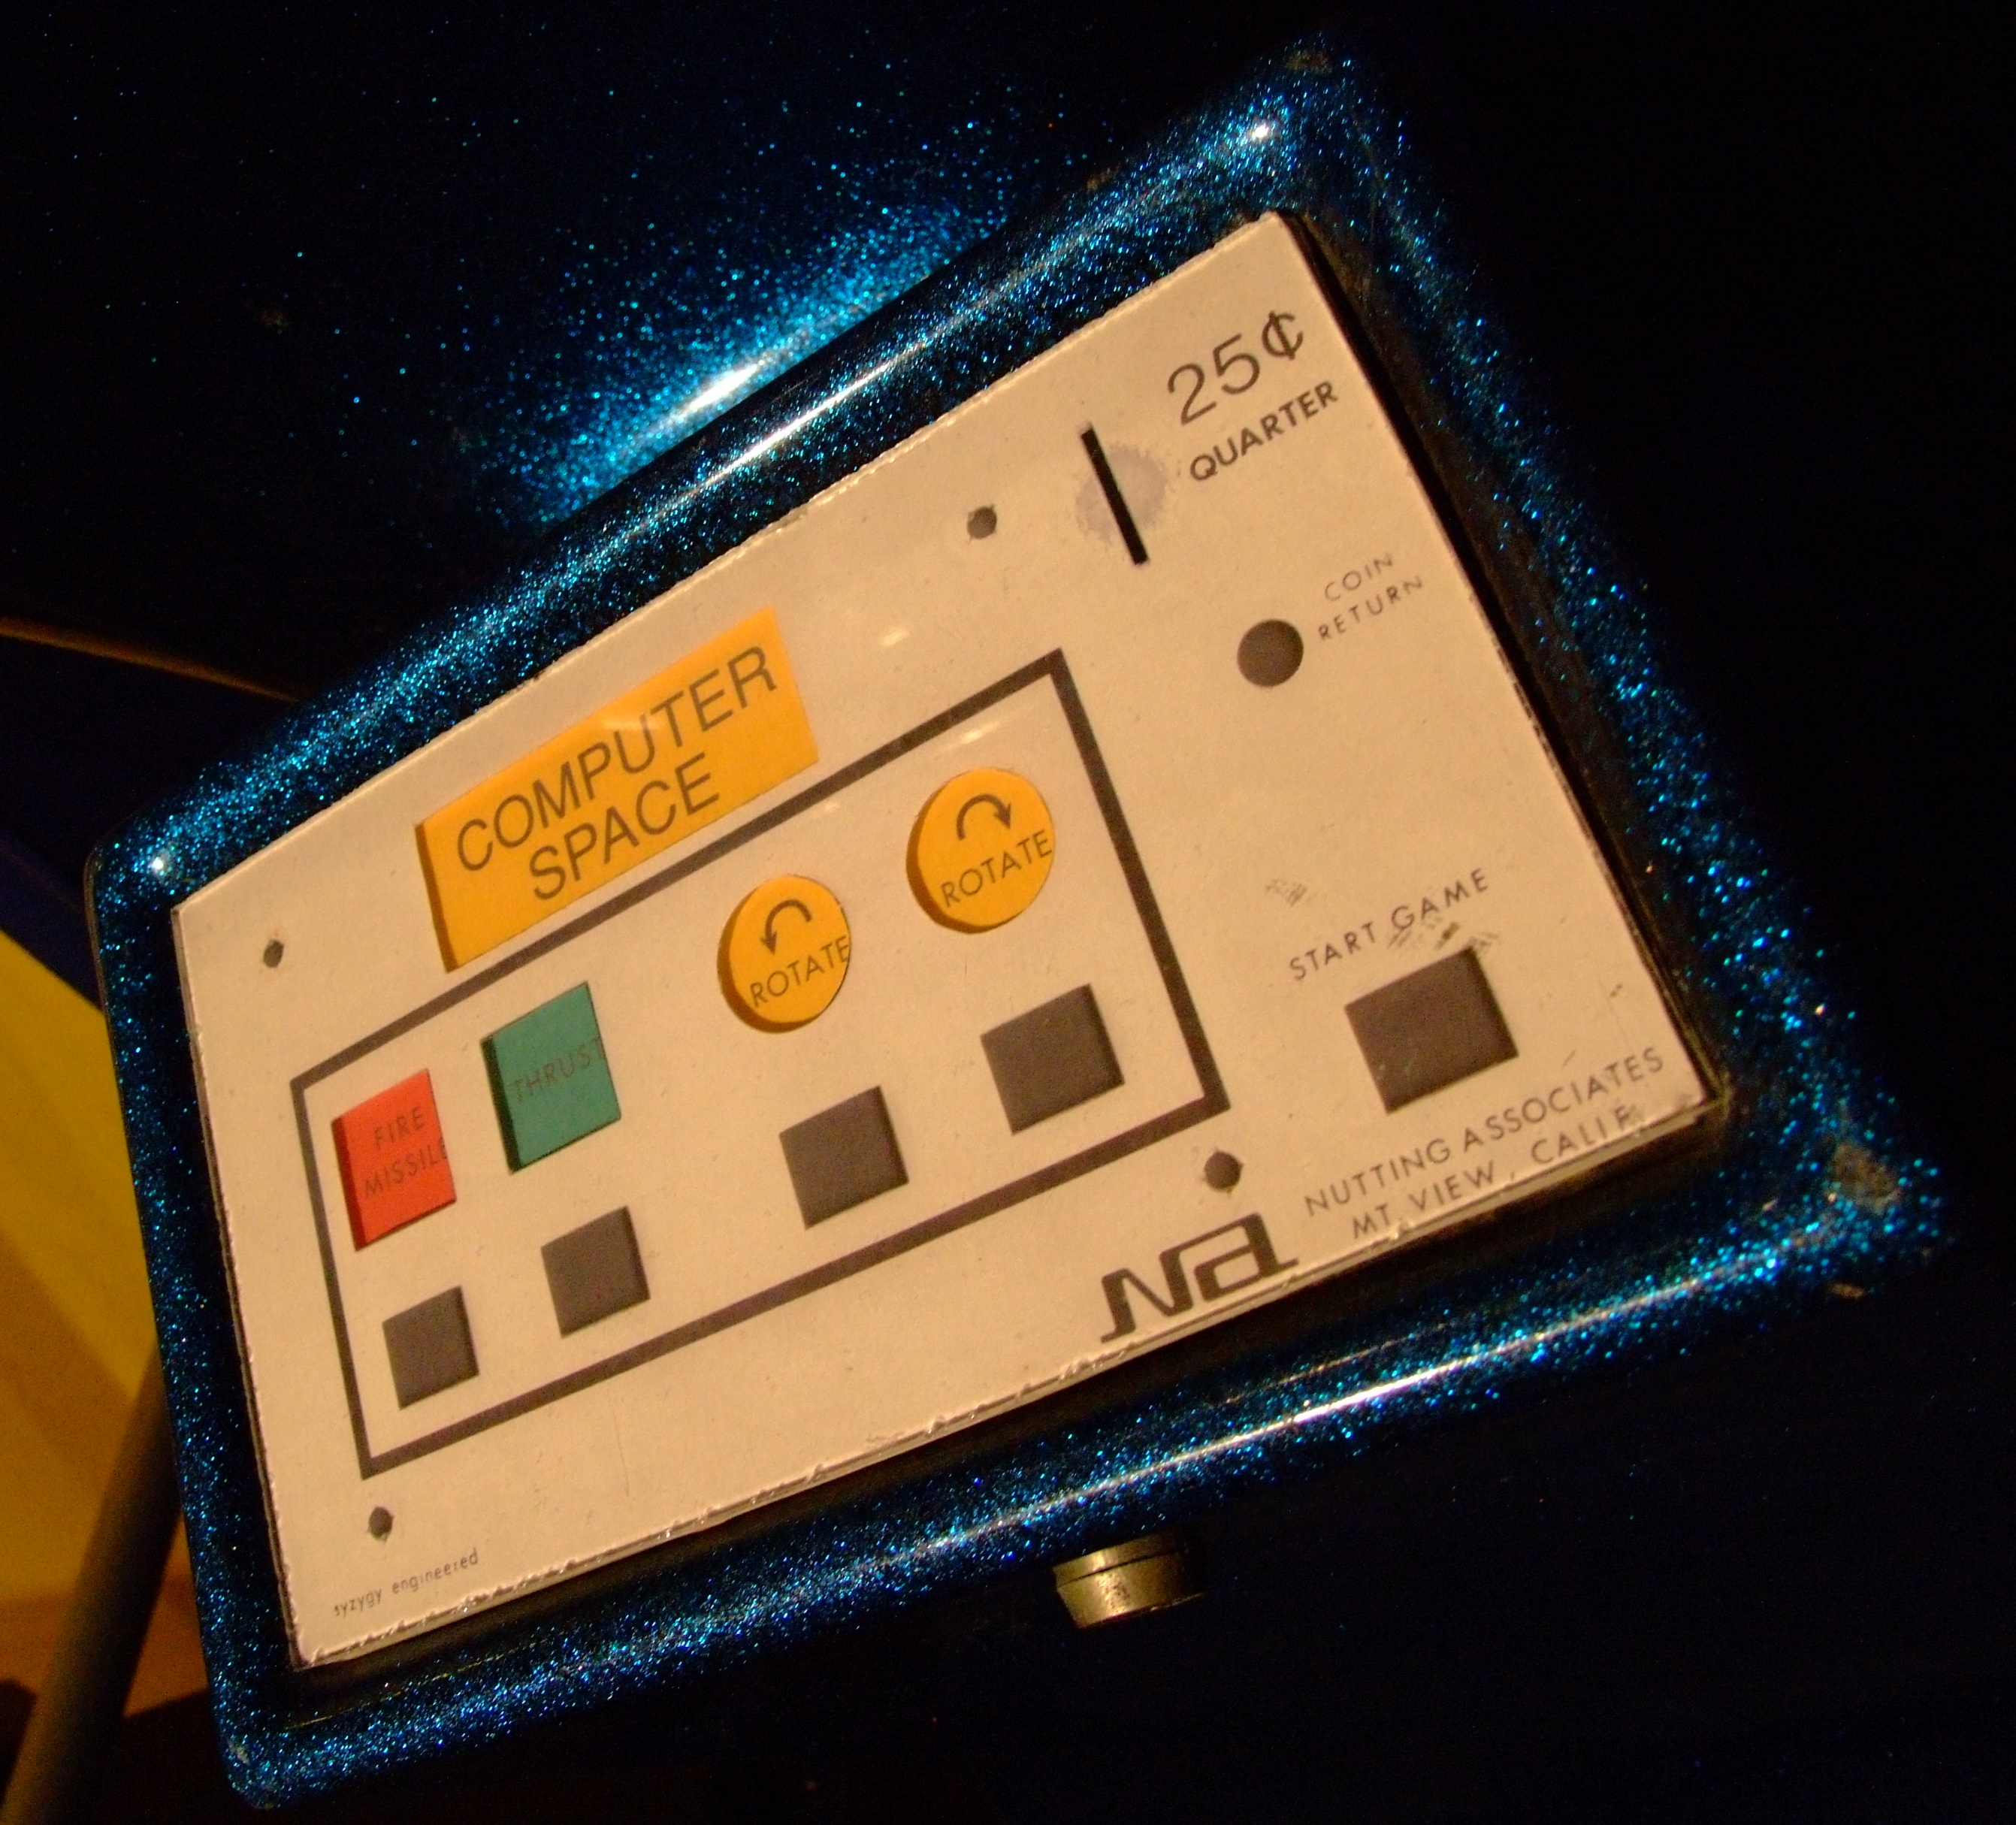
1972: Highest-grossing Arcade Games
#1 Computer Space
200 cabinets
#2 Pong
1 cabinet

Slide 8
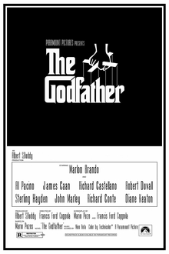
1972: Highest-Grossing Movie

Slide 9

1972: Most Popular Song
The First Time Ever I Saw Your Face Roberta Flack

Slide 10
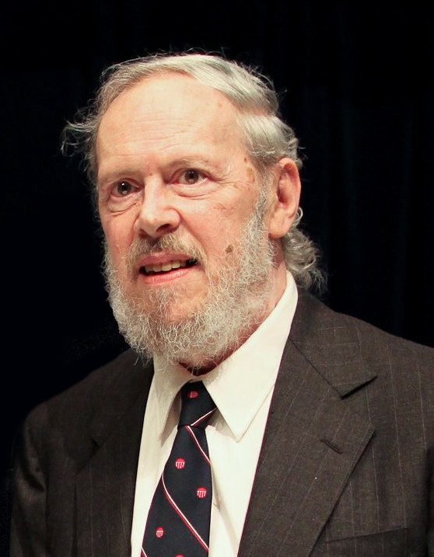
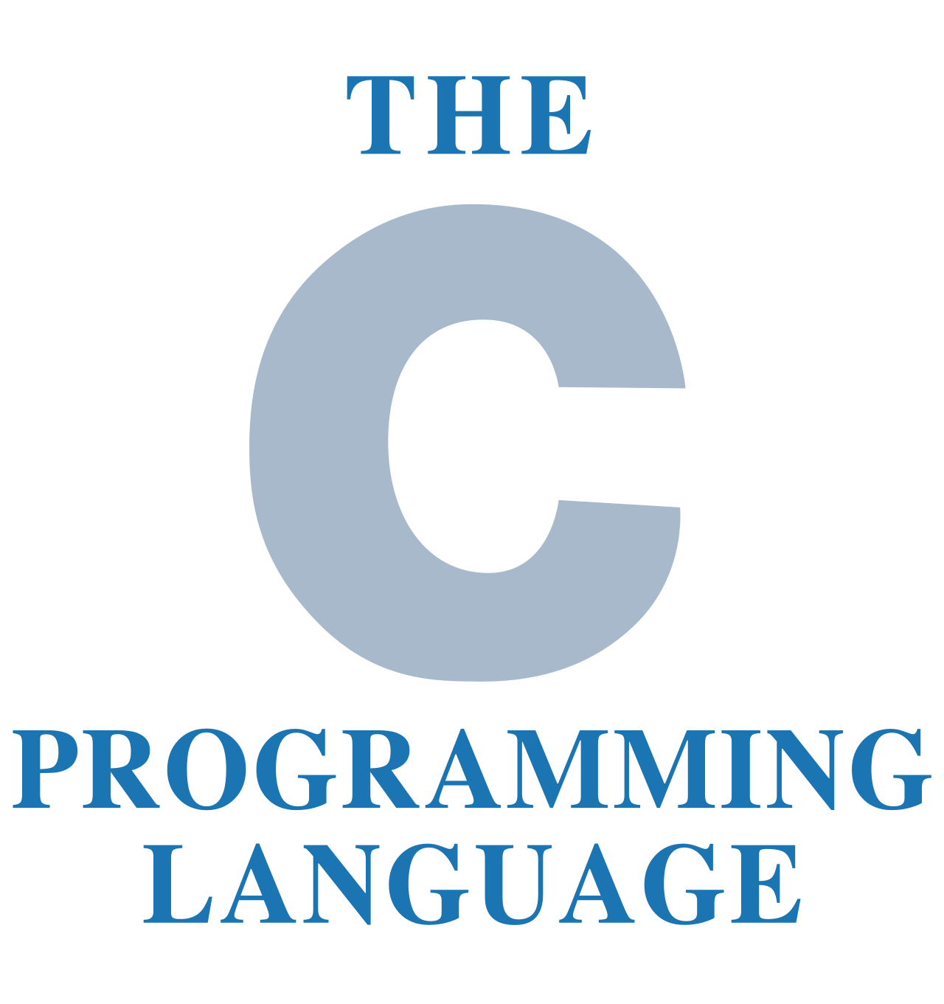
1972: First Appearances
Dennis Ritchie

Slide 11
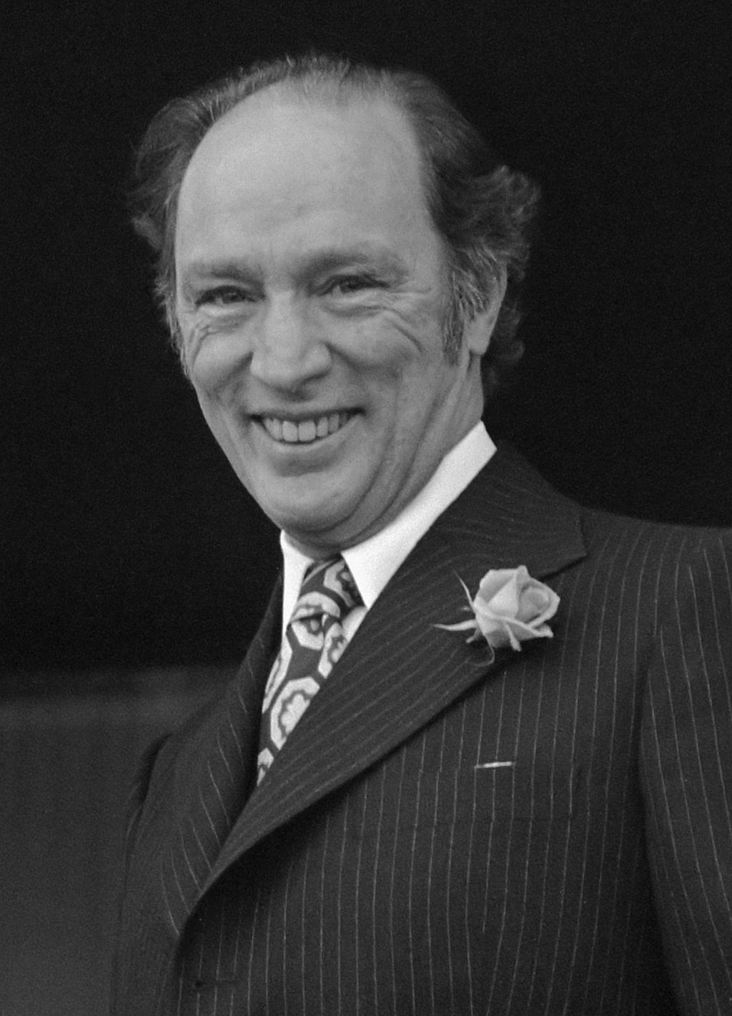
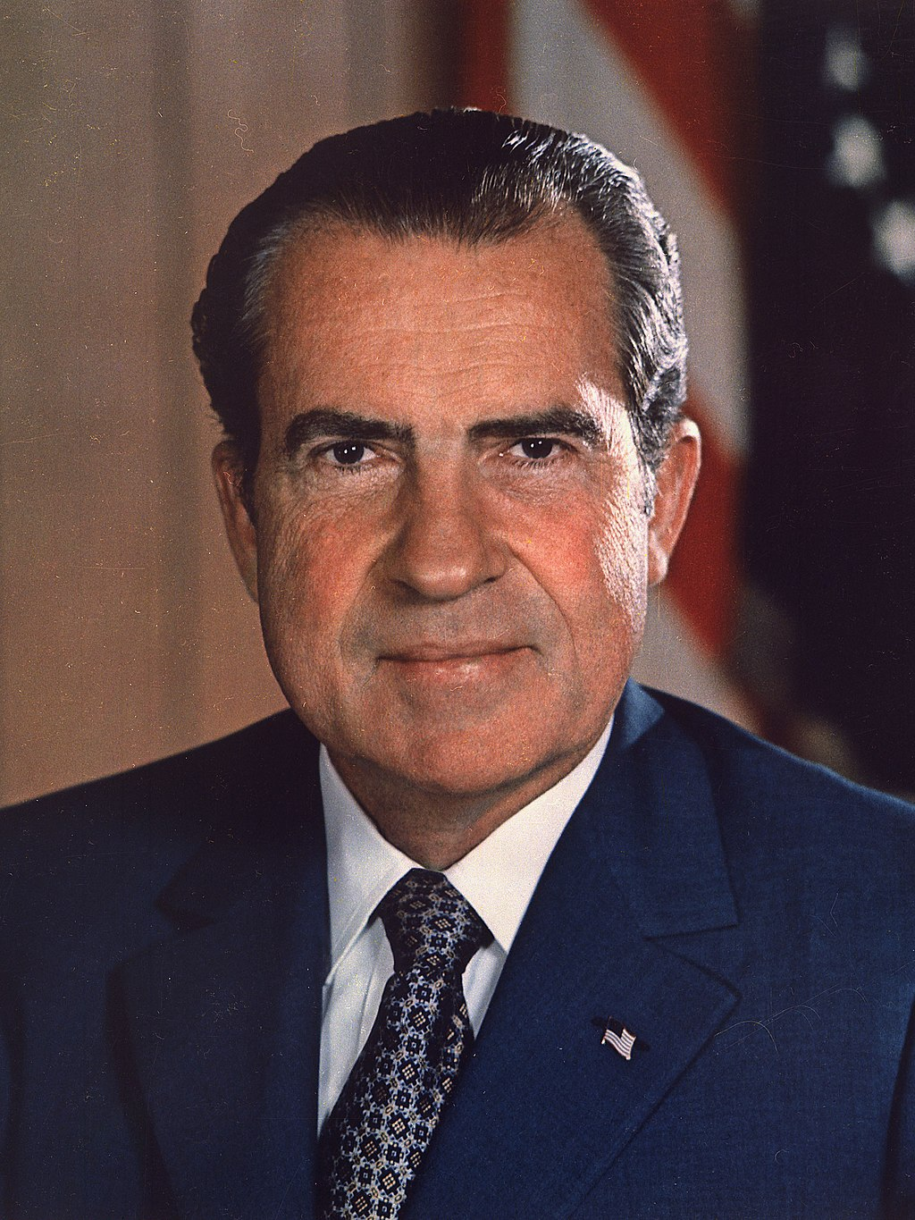
1972
Canadian PM
US President
Pierre Trudeau
Richard Nixon

Slide 12
Prolog
1972
A logic-based programming language associated with symbolic artificial intelligence.

Slide 13
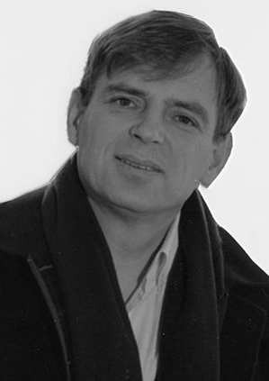

Prolog’s Creators
Alain Colmerauer (1941 – 2017)
Robert Kowalski

Slide 14
Prolog Probably Can’t Get You a Job!
Prolog has been most influential as a research language used by AI researchers.
It also has some relevance to database processing, and declarative languages such as SQL.

Slide 15
What’s Prolog Good for?
Computational logic, e.g. theorem-proving.
Symbolic artificial intelligence.
Parsing natural language.

Slide 16
What’s Prolog Not so Good For?
Prolog is often not as efficient as other languages.
Prolog uses simple depth-first search, and needs heuristics to improve that.
Often stores large databases, and efficiently querying those databases can be difficult.
Prolog is not used much in practice, so it can be hard to find support for it.
Prolog has a very logical flavor, which appeals to some people, but turns others off.
Prolog syntax and semantics is quite different than other languages.
Measuring the performance of different programming languages is surprisingly difficult to do fairly. Check out the Computer Language Benchmarks Game.

Slide 17
Major Features of Prolog
Functions are first-class objects
Functions can be passed and returned (closures)
Interpreted
Easy to evaluate individual expressions
Memory-safe and garbage-collected
No manual memory deletion

Slide 18
Major Features of Prolog
Types
Dynamically typed, i.e. types checked at run-time
Pattern matching (unification)
Given two expressions with variables in them, Prolog can find values for those variables that make them the same (very useful!)
Declarative (sometimes)
You can often think of a Prolog program as describing a goal state without saying exactly how to find it. It automatically searches for a solution using depth-first search.
Automatic backtracking
After finding a solution to a problem, Prolog can automatically backtrack to decision points and make different choices.

Slide 19
Major Features Not in Prolog
Features not part of Prolog
No functional programming (at least not in the style of Racket/Haskell)
No object-oriented programming
No loops

Slide 20
Hello World in Prolog
Please use install and run SWI-Prolog. See the course notes or SWI-Prolog website for installation instructions.
?- write('Hello, world!').
Hello, world!
true.

